Slide 1
Capstone Engagement
Assessment, Analysis, and Hardening of a Vulnerable System Prepared By: Sihanu Subasingha

Slide 2
Table of Contents
This document contains the following sections:
01
Network Topology
02
Red Team: Security Assessment
Blue Team: Log Analysis and Attack Characterization
03
Hardening: Proposed Alarms and Mitigation Strategies
04

Slide 3
Network Topology
3

Slide 4
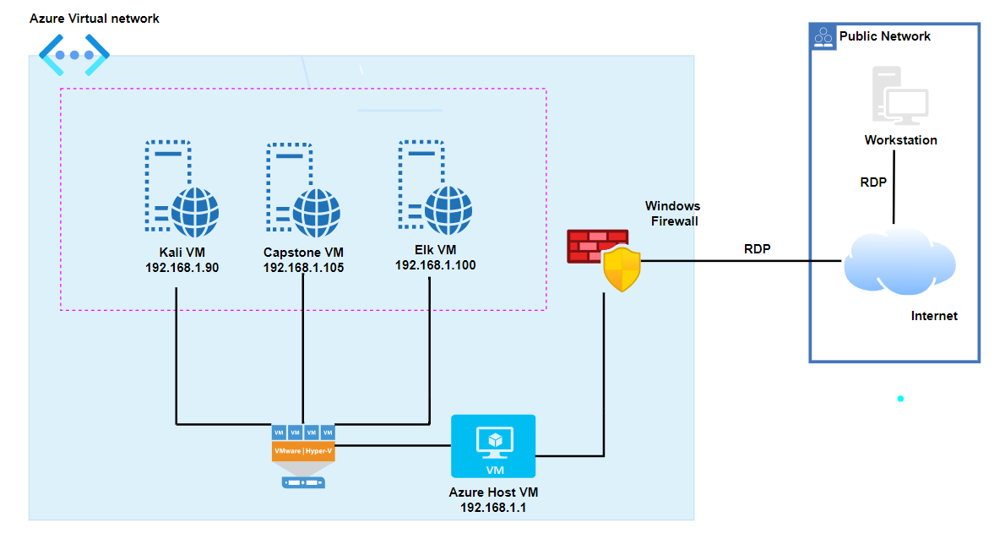
Network Topology
Network
Address Range: 192.168.1.0/24
Netmask:
255.255.255.0
Gateway:
192.168.1.1
Machines
IPv4: 192.168.1.1
OS: Windows
Hostname: ML-REFVM-684427
IPv4: 192.168.1.90
OS: Kali Linux
Hostname: Kali
IPv4: 192.168.1.100
OS: Linux
Hostname: Elk-VM
IPv4: 192.168.1.105
OS: Linux
Hostname: Capstone-VM

Slide 5

Red Team
Security Assessment
5

Slide 6
Recon: Describing the Target
Nmap identified the following hosts on the network:
Hostname | IP Address | Role on Network
ML-REFVM-684427 | 192.168.1.1 | Cloud based host machine with Hyper-v natswitch
Kali | 192.168.1.90 | Attacking machine/Penetration testing machine
ELK | 192.168.1.100 | Elk server/SIEM system
Capstione | 192.168.1.105 | Vulnerable web server

Slide 7
Vulnerability Assessment
The assessment uncovered the following critical vulnerabilities in the target:
Vulnerability | Description | Impact
Exposure of Information Through Directory Listing: CWE-548 | Directory listing enable viewing directories and files to gather information | Attacker can view directories and files in capstone web server
Absolute Path Traversal: CWE-36 | Directory listing enable user to browse through directories capstone web server. Most importantly hidden folders to public can be found as well | Attacker can locate /company_folders/secret_folder/ even though it is not in directory listing. So attacker can access to directory contents which reveal sensitive information such as admin of secret_folder is Ashton, ryan’s password hash and how to navigate to /webdav server.

Slide 8
Vulnerability Assessment
The assessment uncovered the following critical vulnerabilities in the target:
Vulnerability | Description | Impact
Simple usernames and weak passwords requirement: CWE-521 | Using simple usernames like person’s first name or last name and using weak password with lack of password complexity | Attacker can easily guess the usernames and password could be easily cracked through brute force. Access to /secret_folder/ was gained easily through brute force by guessing ashton as username. Further user name for /webdav is ryan.
Crack password through brute force without any interruptions. | Brute force attack was done easily without any trouble. Account lockout policy was not implemented for failed login attempts. | Attacker can easily get access to /company_folders/secret_folder/ and view connect_to_corp_server file.
Use of a One-Way Hash without a Salt: CWE-759 | Unsalted hashes can be easily cracked using Crack Station website or John the Ripper | Atacker can cracked the hash for /webdav server and login to it.

Slide 9
Vulnerability Assessment
The assessment uncovered the following critical vulnerabilities in the target:
Vulnerability | Description | Impact
WebDAV Remote Code Execution Vulnerability: CVE-2017-7269 Unrestricted Upload of File with Dangerous Type: CWE-434 | Shell access to webdav is enable and uploading of malicious script is not restricted. | Malicious payload can be easily upload into /webdav server to exploit reverse shell attack.
Reverse Shell Backdoor deployment | Reverse shell payload is successfully exploited, and persistent connection could be established. | Remote backdoor shell access to capstone server can be obtained and affects to CIA triad.

Slide 10
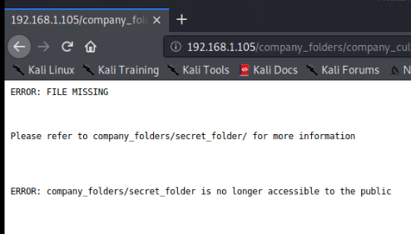
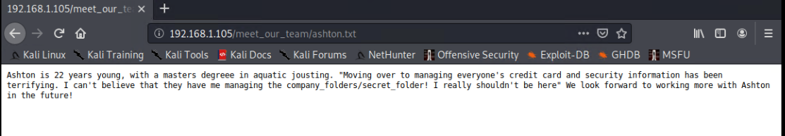
Exploitation: Exposure of Information Through Directory Listing
01
02
03
Tools & Processes
Forefox Browser
Achievements
Basic reconnaissance was done by browsing directories and viewing files.
Some files have note referring company_folders/secret_folder
Further admin for the secret_folder was found as Ashton

Slide 11
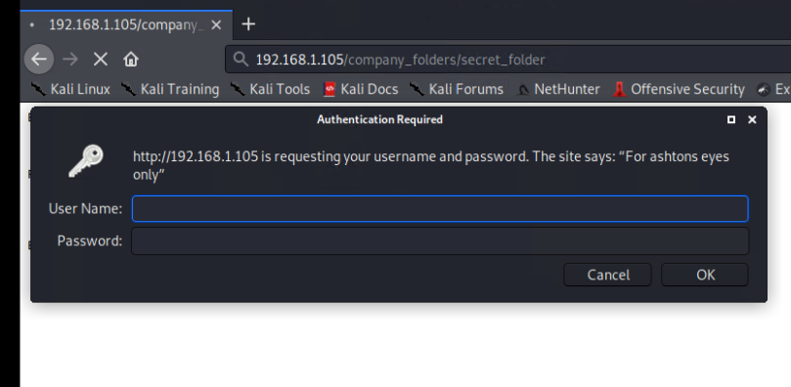
Exploitation: Absolute Path Traversal
01
02
03
Tools & Processes
Firefox Browser
Achievements
Secret_folder was found and noticed that it was password protected.

Slide 12
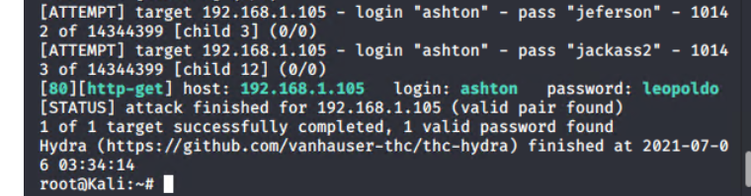
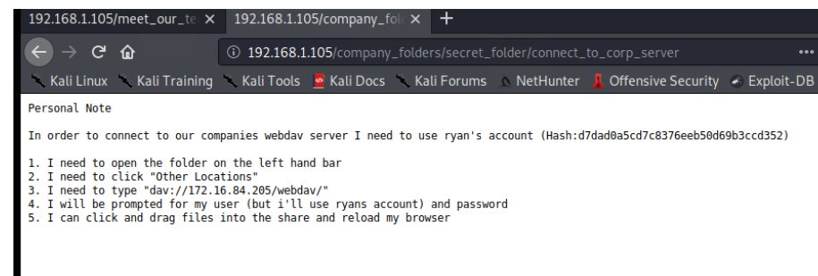
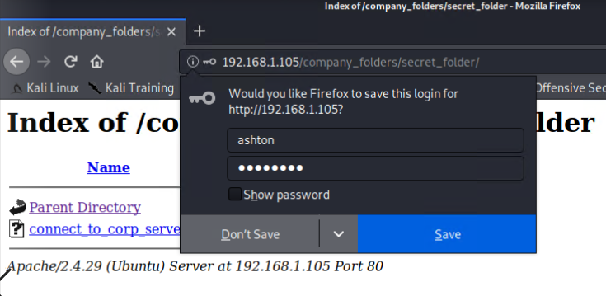
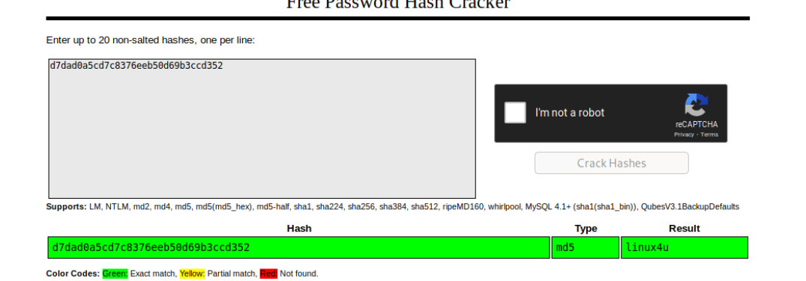
Exploitation: Simple usernames and weak passwords/hashes and No-account lookout for brute force
01
02
03
Tools & Processes
Hydra brute force dictionary attack was preformed to crack password to secret_folder. Rockyou.txt word-list was used for this attack.
Achievements
Password for secret_folder was found as leopoldo.
Access to secret_folder was gained.
File containing login instruction and hash password to /webdav server was found.

Slide 13
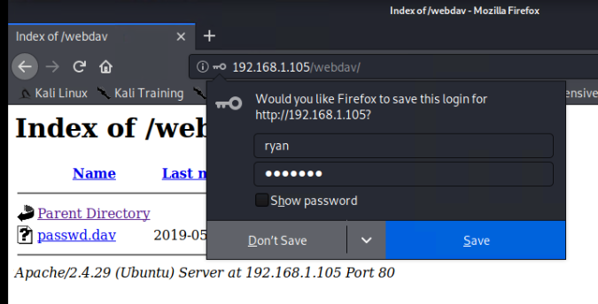
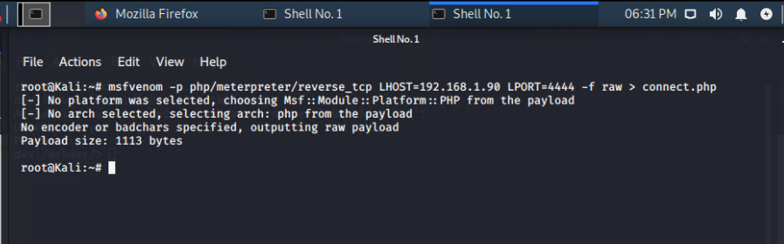
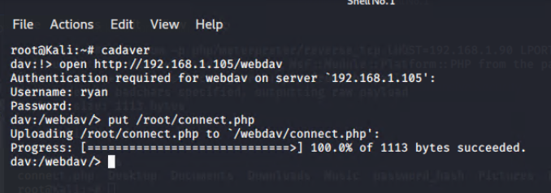
Exploitation: webdav Vulnerability
01
02
03
Tools & Processes
Msfvenom to create custom payload in kali.
Cadaver command line to gain access to /webdav and upload custom payload.
Achievements
Custom payload was created.
Shell access to /webdav was gained through cadaver.
Malicious file called connect.php was uploaded to /webdav as custom payload.

Slide 14
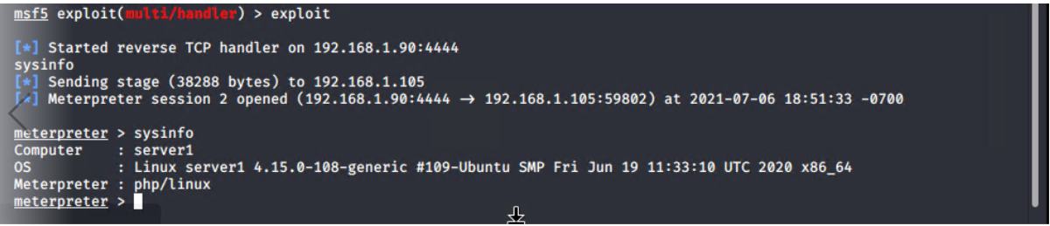
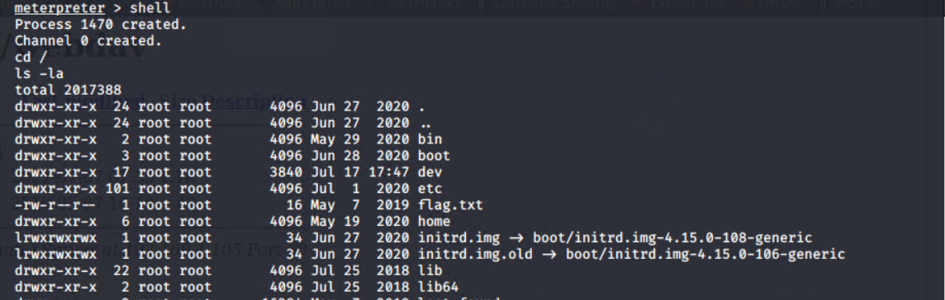
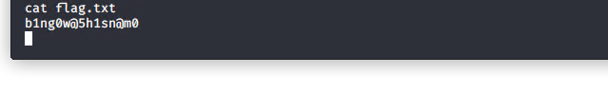
Exploitation: Reverse Shell Backdoor deployment
01
02
03
Tools & Processes
Meterpreter:
msfconsole in kali
Firefox Browser
Shell command
Achievements
Remote backdoor shell session for capstone server was achieved.
Access to directories of server gained.
Flag.txt was found

Slide 15

Blue Team
Log Analysis and Attack Characterization
15

Slide 16
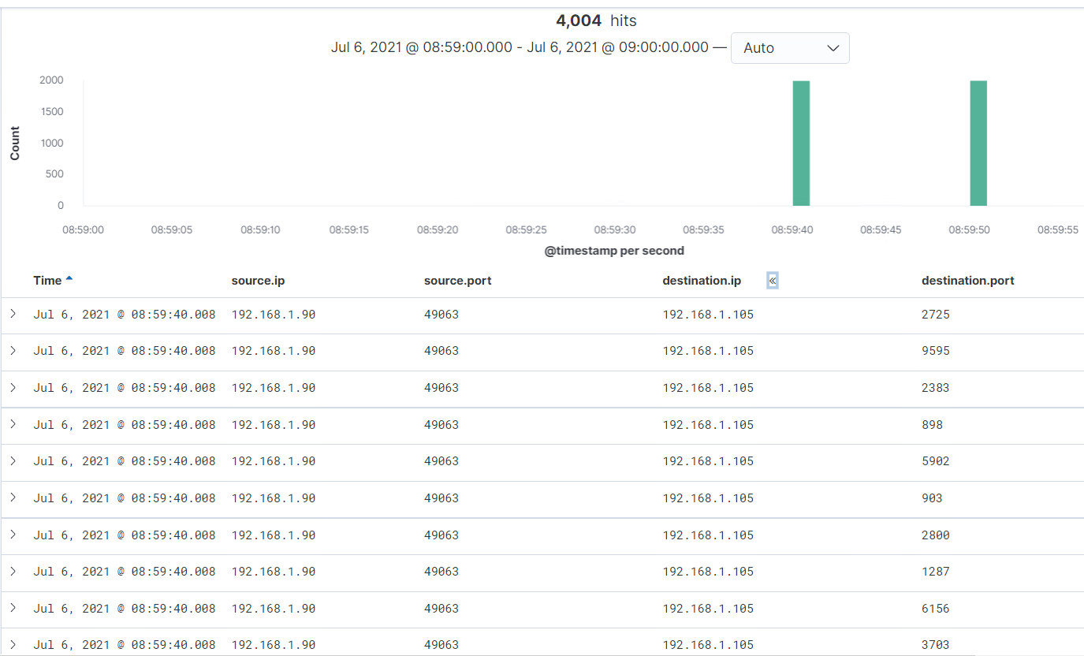
Analysis: Identifying the Port Scan
Port scan occurs on 6th of July 2021 at 08:59
4004 Packets were sent from which IP 192.168.1.90 kali machine
Large number of packets were sent from source to target during short period and single source port, 49063 sent packets to different destination ports as in figure. This indicates that this was a port scan.

Slide 17
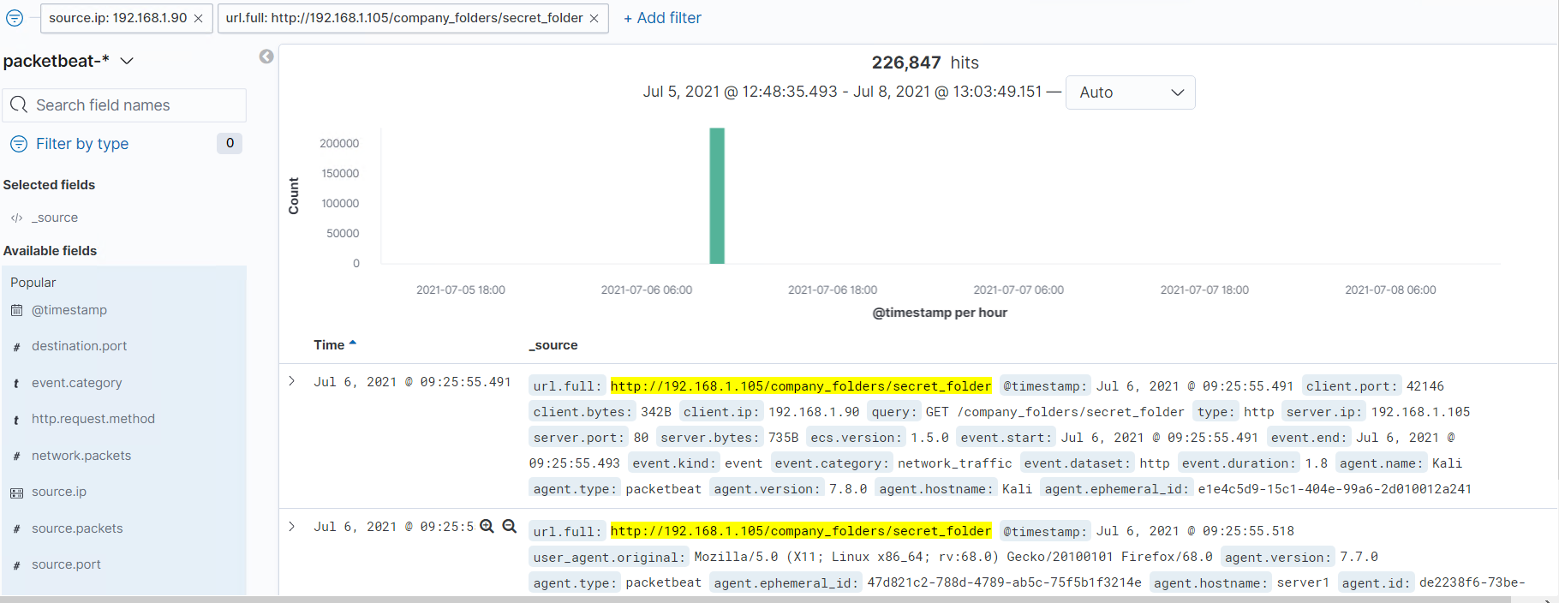
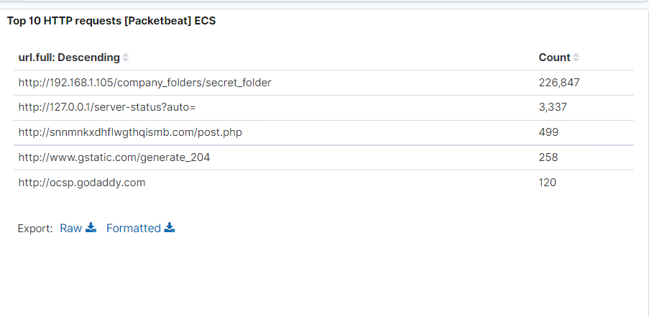
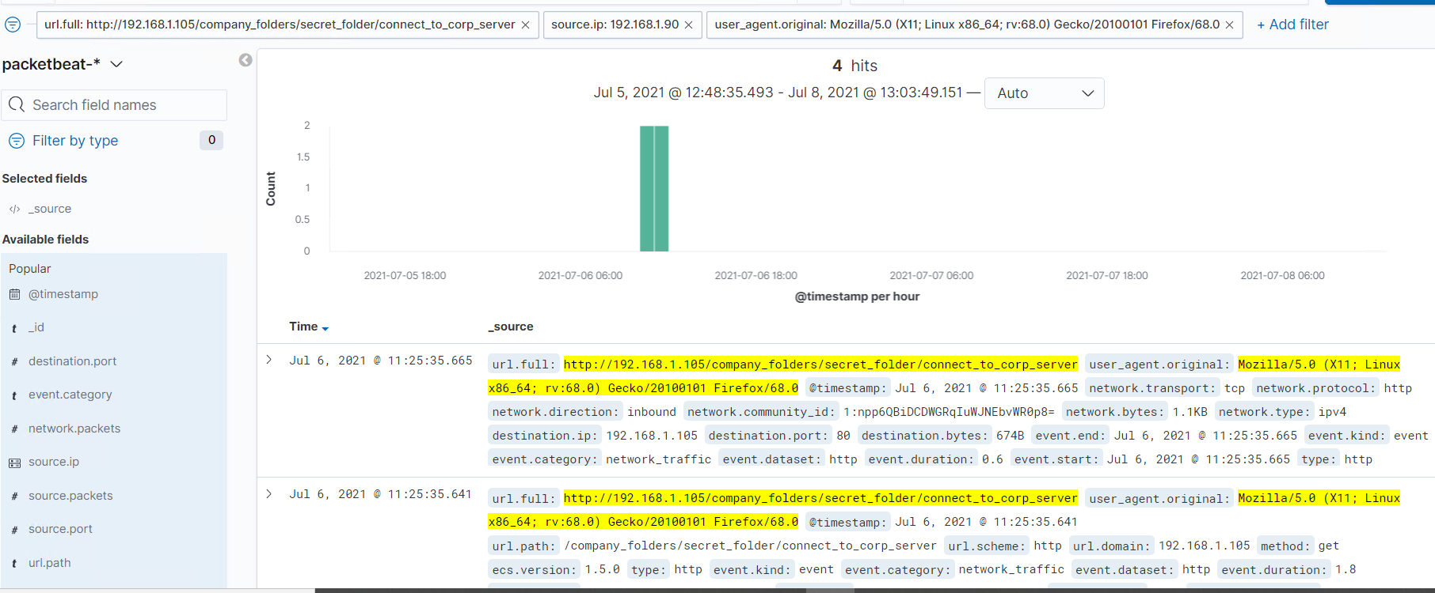
Analysis: Finding the Request for the Hidden Directory
The request occur at 6th of july 2021 at 09:25:55 and 226.847 requests were made.
The file requested was connect_to_corp_server and it contain intruction to login for /webdav.

Slide 18
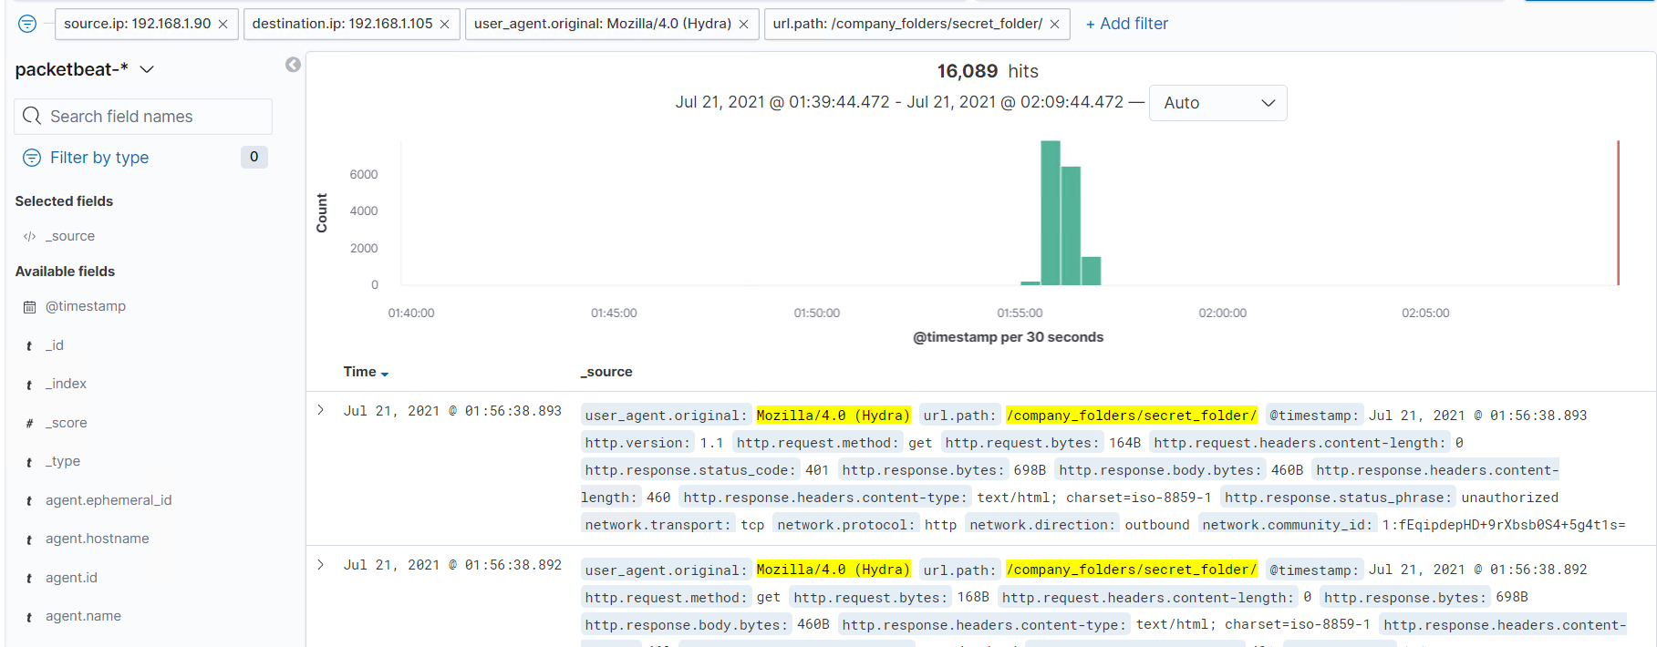
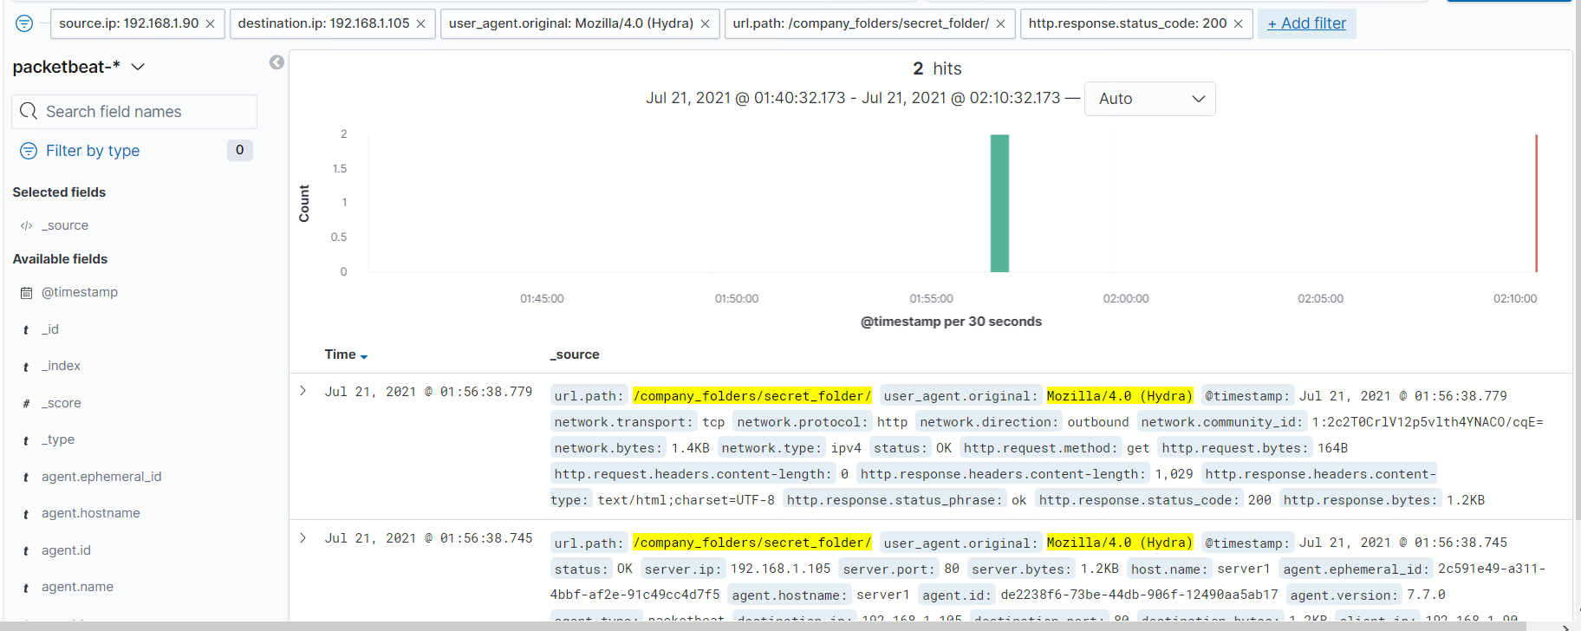
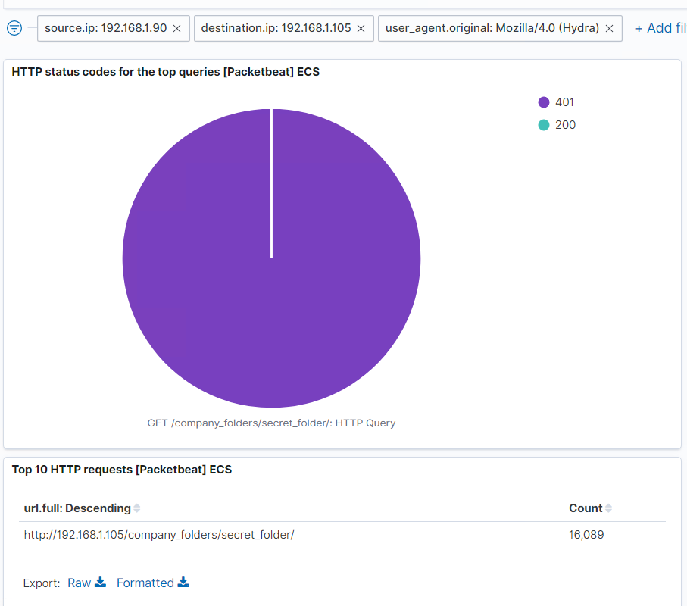
Analysis: Uncovering the Brute Force Attack
16,089 requests were made in the attack?.
226.825 requests had been made before the attacker discovered the password.

Slide 19
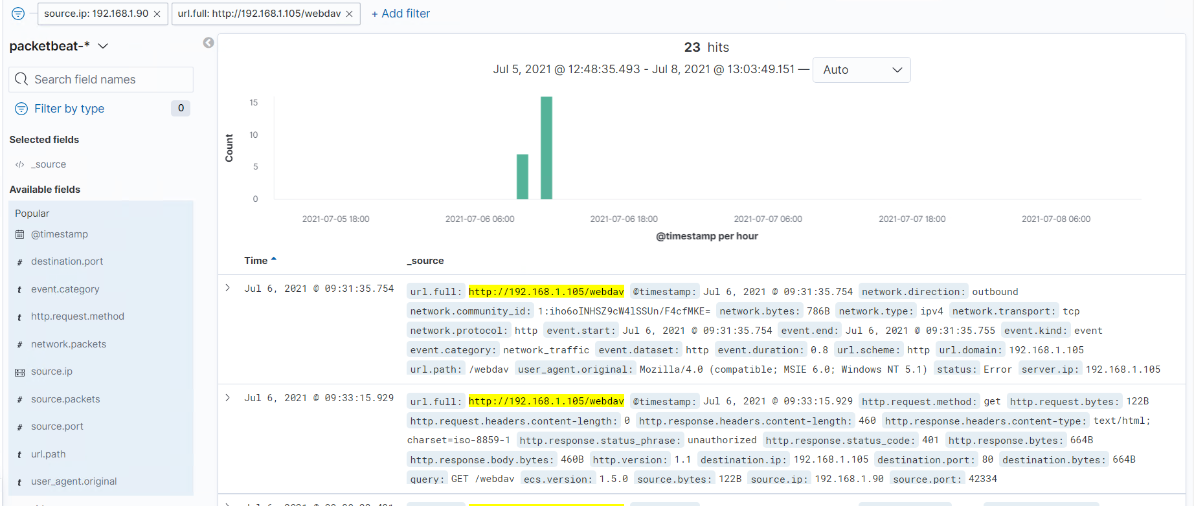
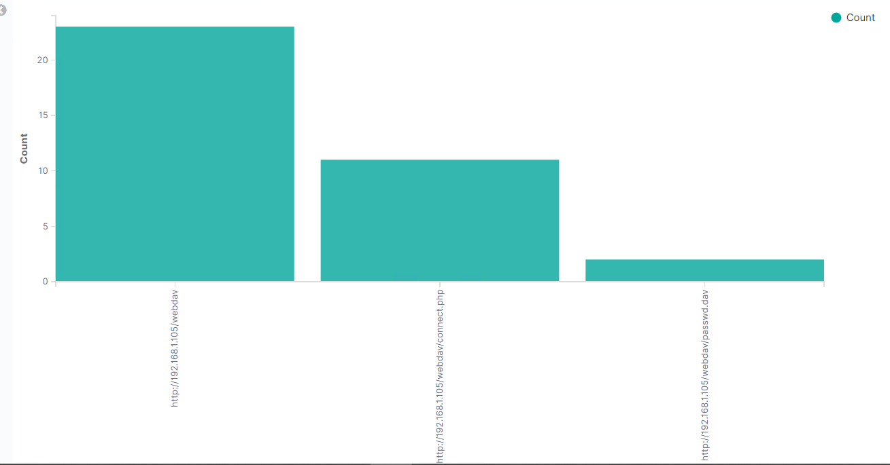
Analysis: Finding the WebDAV Connection
There were 23 requests were made to /webdav directory.
Connect.php (mallisious payload) and passwd.dav files were requested.

Slide 20
Blue Team
Proposed Alarms and Mitigation Strategies
20

Slide 21
Mitigation: Blocking the Port Scan
Normally Port scanning perform through single port of an IP.
It is quick and noisy process which execute more than thousand of requests per few seconds.
Recommended threshold is 20 per second per given IP.
Whitelist required IPs and block/delay/forward unauthorised port scanning through firewall.
Close all other ports except 80 and 443 if required. Regular update services running in open ports
Utilize IDS/SIEM system generate logs, reports and allert in case of attack.

Slide 22
Mitigation: Finding the Request for the Hidden Directory
Secret_folder should only have access authorized personals.
If unauothorized IP try to get access to secret_folder an alert should be generated.
Recommended threshold for unauthorized IP is 0. Any attempt more than 0 should be forbid.
Recommended threshold for authorized IP can be set to 5 failed login per minute.
Create firewall rules to whitelist authorized users and IPs to access secret_folder.
Enable multifactor authentication for login
Disable directory listing and path traversal.
Utilize IDS/SIEM system generate logs, reports and alert for unauthorized access and failed logins.

Slide 23
Mitigation: Preventing Brute Force Attacks
During brute force attack large number of requests were made to secret_folder in web server.
During hydra attack user agent was Mozilla/4.0(Hydra)
Http response code for unsuccessful login is 401 and successful login is 200 or 301.
Threshold for brute force attack can be set as 10 failed login per second from Mozilla/4.0(Hydra) for secret_folder.
Implement strong password policy
Use complex usernames
Enable multifactor authentication for login
Account lockout for failed login than threshold level.
Limit the traffic to black brute force attacks
Utilize IDS/SIEM system generate logs, reports and alert for unauthorized access and failed logins.

Slide 24
Mitigation: Detecting the WebDAV Connection
Webdav/ should only have access authorized personals.
If unauothorized IP try to get access to webdav/ an alert should be generated.
Recommended threshold for unauthorized IP is 0. Any attempt more than 0 should be forbid.
Recommended threshold for authorized IP can be set to 5 failed login per minute.
Create firewall rules to whitelist authorized users and IPs to access webdav/.
Enable multifactor authentication for login
Disable path traversal.
Use a salt when storing hashed passwords
Upgrade webdav server regulary
Utilize IDS/SIEM system generate logs, reports and alert for unauthorized access and failed logins.

Slide 25
Mitigation: Identifying Reverse Shell Uploads
During attack php file was uploaded to /webdav server.
File uploading to /webdav should only done by authorized Ips
Recommended threshold of unauthorized file uploading to /webdav should be 0.
Further it is recommended to generate alerts when traffic generate between server and external IP except port 80 of server.
whitelisting authorized IPs to upload files in /webdav server using firewall rules.
Restrict uploading files with extension of .php, .exe, .bat, .exe, .vbs or .pif, .
Setup antivirus/antimalware to scan files being uploaded.
Utilize IDS/SIEM system generate logs, reports and alert for unauthorized file uploading or traffic with external IPs other than port 80..

